Slide 1
Week 4 Control Statements Part 1
CS 331
An introduction to C++ and Object-Oriented Programming
MD Romael Haque

Slide 2
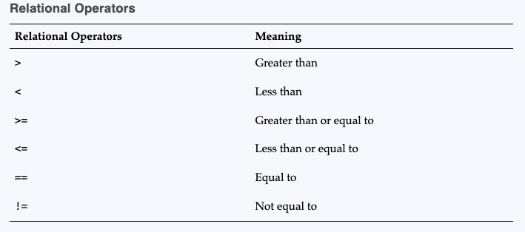
Relational Operators
Relational operators allow you to compare numeric and char values and determine whether one is greater than, less than, equal to, or not equal to another.

Slide 3
Boolean expressions
X>Y: This expression is called a relational expression.
Relational expressions are Boolean expressions, which means their value can only be true or false. If x is greater than y, the expression x > y will be true and the expression x < y will be false.
Two of the relational operators actually test for a pair of relationships. The >= operator determines whether the operand on its left is greater than or equal to the operand on the right.

Slide 4
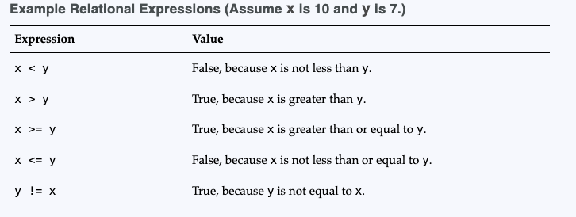
Examples

Slide 5
What is truth?
If a relational expression can evaluate to either true or false, how are those values represented internally in a program? How does a computer store true in memory? How does it store false?
The C++ keyword false is stored as 0, and the keyword true is stored as 1. And when a relational expression is false, it evaluates to 0.
However, when a relational expression is true, it does not always evaluate to 1. Though it usually does, it can actually evaluate to any nonzero value.

Slide 6
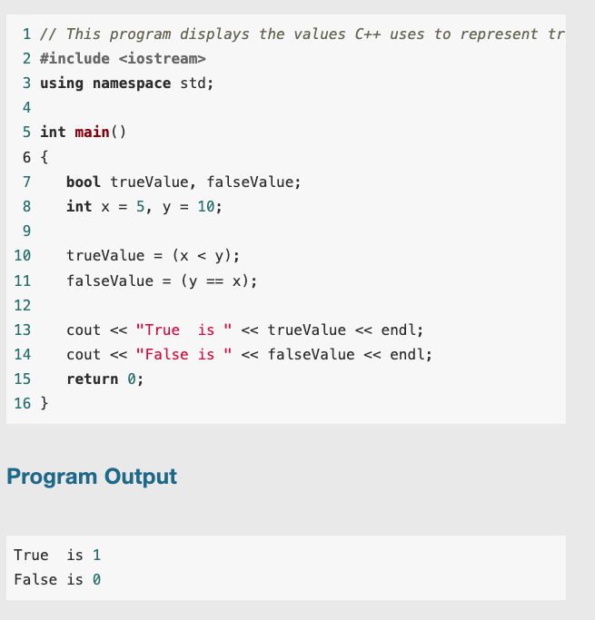
What is truth?

Slide 7
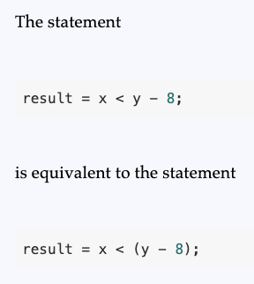
Precedence in RA
Arithmetic operators have a higher precedence than relational operators.
It is always a good idea to place parentheses around an arithmetic expression when its result will be used in a relational expression.

Slide 8
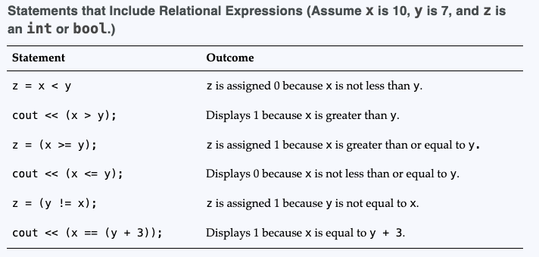
Precedence in RA

Slide 9
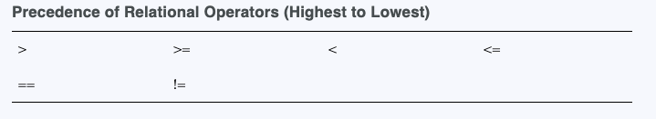
Precedence in RA
Relational operators also have a precedence order among themselves.
The two operators that test for equality or lack of equality (== and !=) have the same precedence as each other.
The four other relational operators, which test relative size, have the same precedence as each other. These four relative relational operators have a higher precedence than the two equality relational operators.
If a = 9, b = 24, and c = 0, the following statement displays a 1.
cout << (c == a > b);

Slide 10
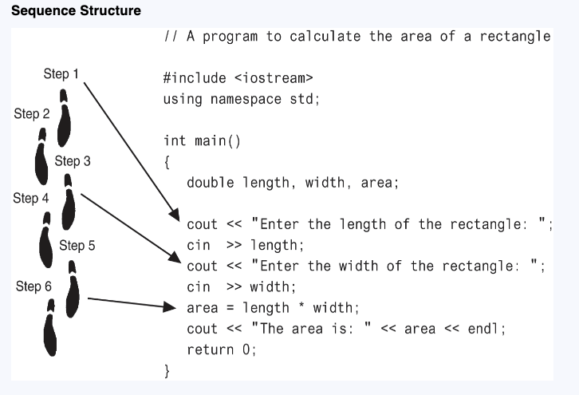
The if Statement

Slide 11
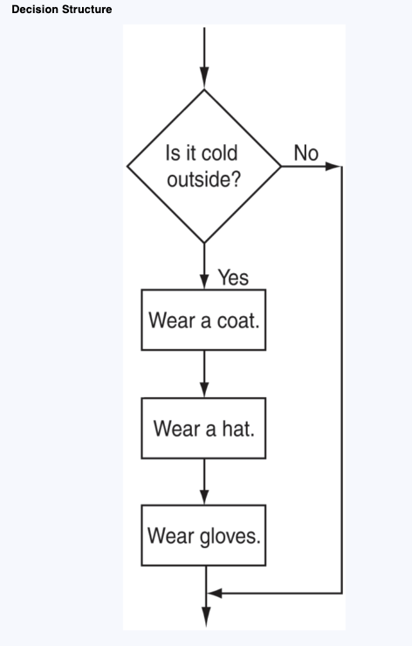
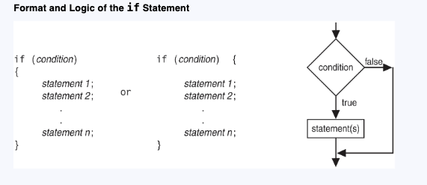
The if Statement

Slide 12
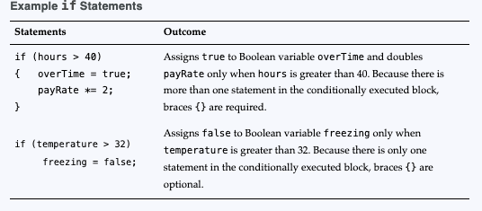
The if Statement

Slide 13
Exercise
The user enters three test scores and the program calculates their average. If the average equals 100, the program congratulates the user on earning a perfect score.

Slide 14

Programming Style and the if Statement
Even though if statements usually span more than one line, they are technically one long statement. For instance, the following if statements are identical except in style:

Slide 15
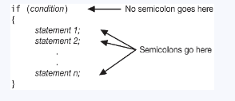
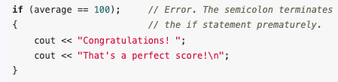
Programming Style and the if Statement
Standard practice:
The conditionally executed statement(s) should begin on the line after the if statement.
The conditionally executed statement(s) should be indented one “level” from the if statement.
Three Common Errors to Watch Out For
Misplaced semicolons; Missing braces; Confusing = with ==

Slide 16
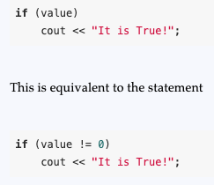
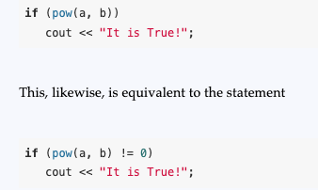
More about Truth

Slide 17


Flags
A flag is a variable that signals whether or not some condition currently exists in a program.
Because bool variables hold the values true and false, they are the perfect type of variables to use for flags.
When the flag variable is set to true, it means the condition does exist. When the flag variable is set to false, it means that the condition does not exist, at least not yet.

Slide 18
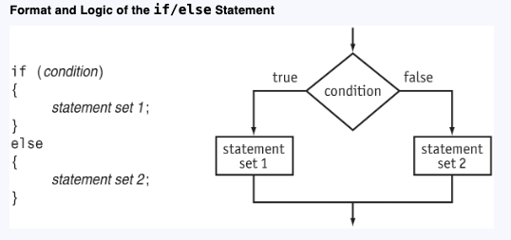
The if/else Statement
The if/else statement executes one set of statements when the if condition is true and another set when the condition is false.

Slide 19
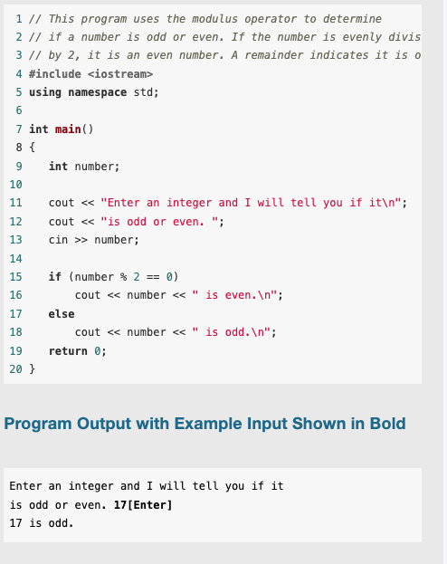
Example

Slide 20
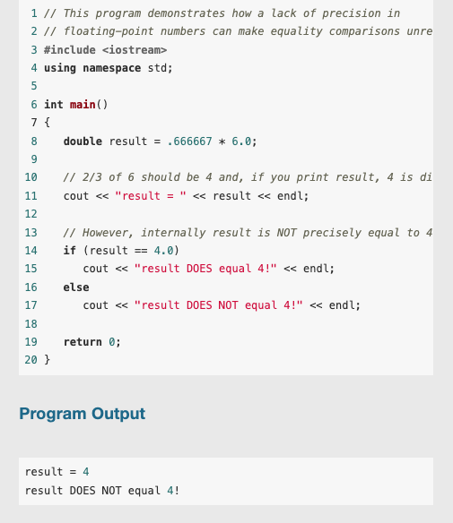
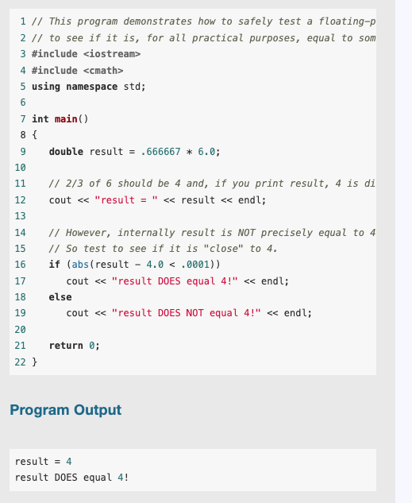
Comparing Floating-Point Numbers
Solution

Slide 21
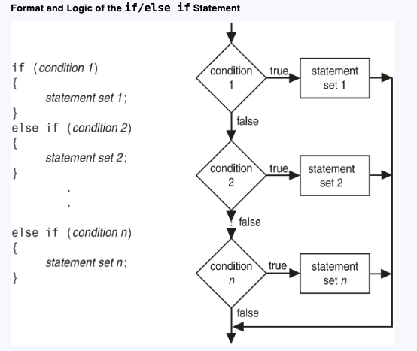
The if/else if Statement
The if/else if statement is a chain of if statements. They perform their tests, one after the other, until one of them is found to be true.

Slide 22
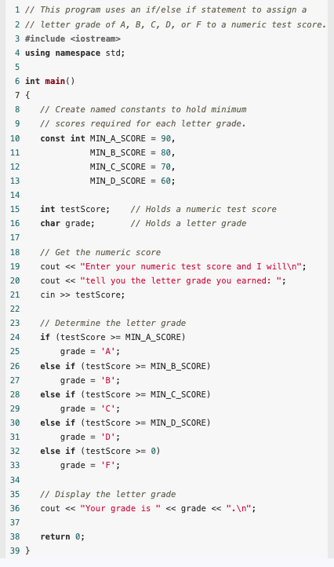
Example

Slide 23
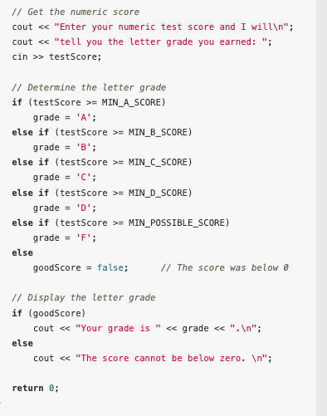
Using a Trailing else

Slide 24
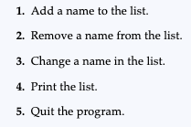
Menu-Driven Programs
A menu is a set of choices presented to the user. A menu-driven program allows the user to determine the course of action by selecting it from the menu.

Slide 25
Exercise
Suppose you are required to calculate the charges for membership in a health club. The club has three membership packages to choose from: standard adult membership, child membership, and senior citizen membership. The program presents a menu that allows the user to choose the desired package and then calculates the cost of the membership.

Slide 26
Nested if Statements
To test more than one condition, an if statement can be nested inside another if statement.
It is possible for one if statement or if/else statement to be placed inside another one. This construct, called a nested if, allows you to test more than one condition to determine which block of code should be executed

Slide 27
Exercise
For example, consider a banking program that determines whether a bank customer qualifies for a special low interest rate on a loan. To qualify, two conditions must exist:
The customer must be currently employed.
The customer must have recently graduated from college (in the past two years).

Slide 28
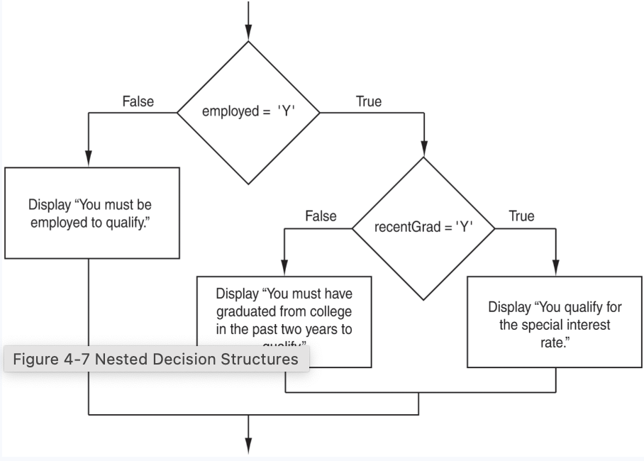
Exercise

Slide 29
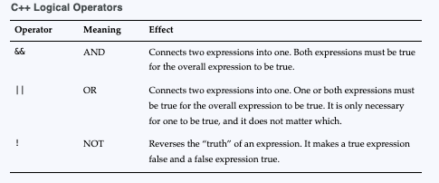
Logical Operators
Logical operators connect two or more relational expressions into one or reverse the logic of an expression.

Slide 30



Examples

Slide 31
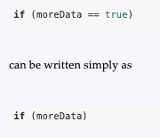
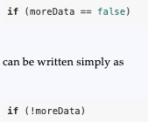
Boolean Variables and the ! Operator

Slide 32
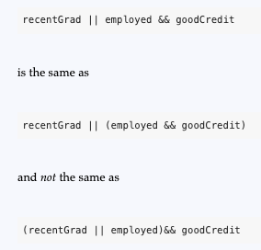
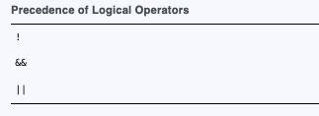
Precedence and Associativity of Logical Operators

Slide 33
Validating User Input
Numbers are checked to ensure they are within a range of possible values. For example, there are 168 hours in a week. It is not possible for a person to be at work longer than 168 hours in one week.
Values are checked for their “reasonableness.” Although it might be possible for a person to be at work for 168 hours per week, it is not probable.
Items selected from a menu or some other set of choices are checked to ensure they are available options.
Variables are checked for values that might cause problems, such as division by zero

Slide 34
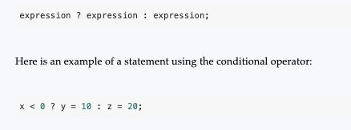

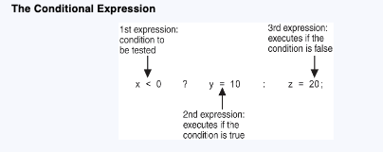
The Conditional Operator
You can use the conditional operator to create short expressions that work like if/else statements.

Slide 35
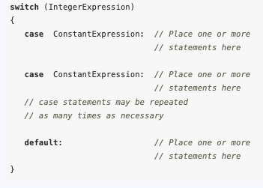
The switch Statement
The switch statement uses the value of a variable or expression to determine where the program will branch to

Slide 36
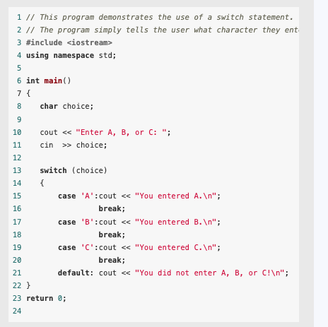
The switch Statement: Example

Slide 37
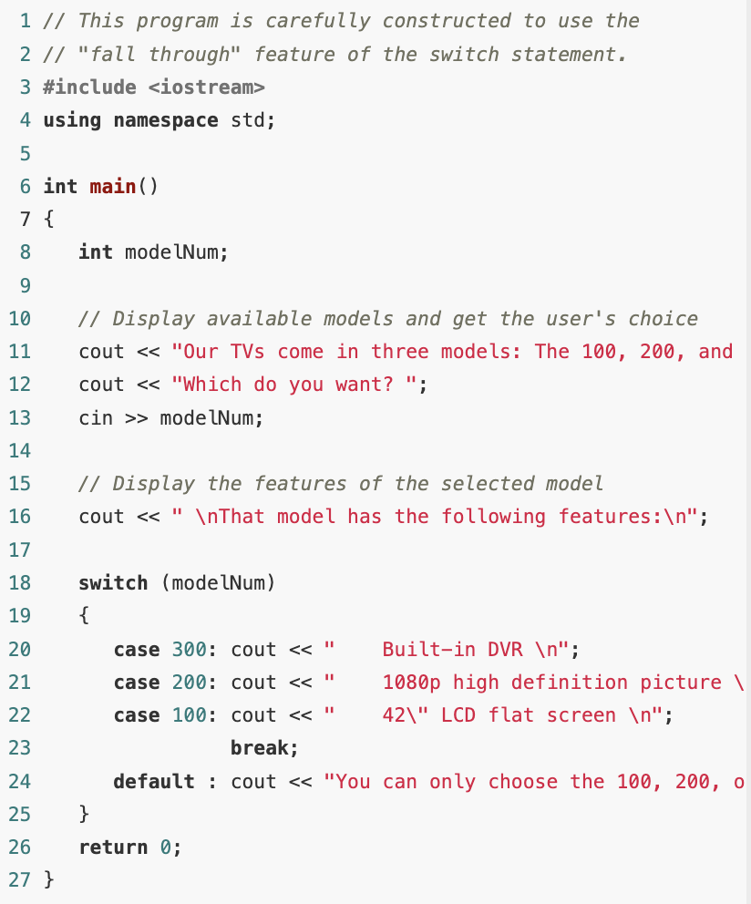
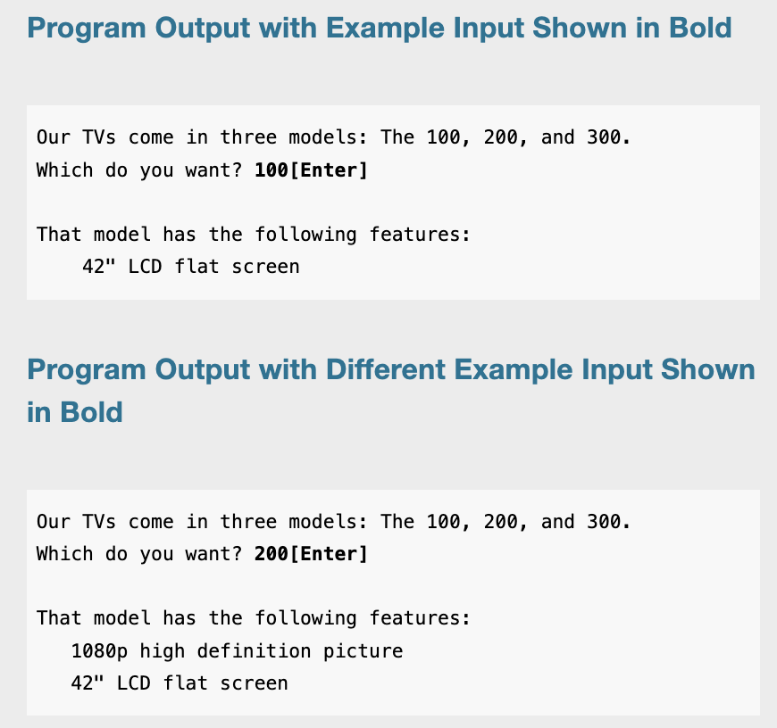
The switch Statement: Example

Slide 38
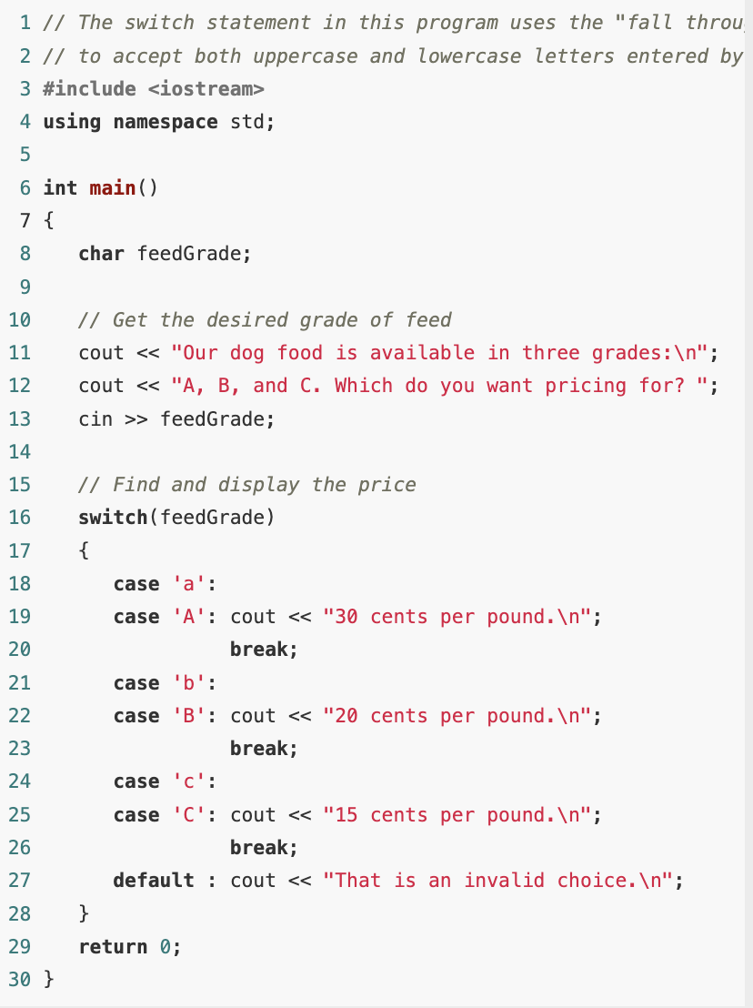
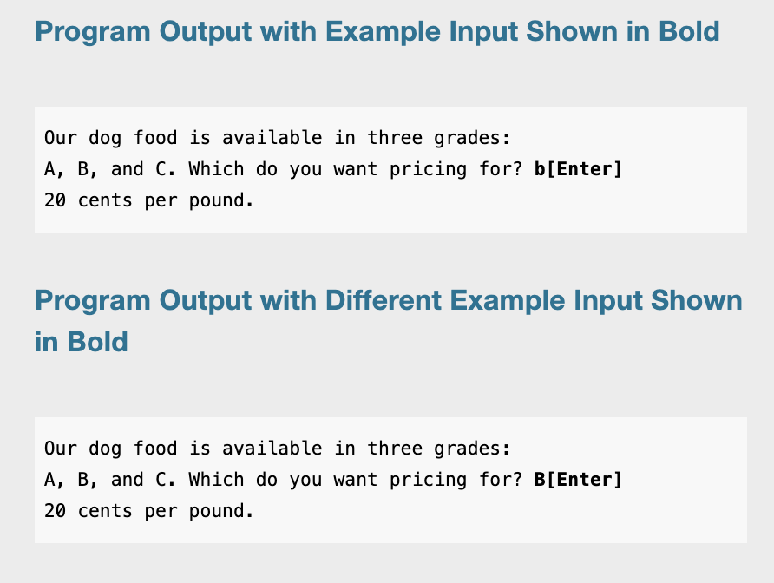
The switch Statement: Example

Slide 39
The switch Statement: menu-driven program
Suppose you are required to calculate the charges for membership in a health club. The club has three membership packages to choose from: standard adult membership, child membership, and senior citizen membership. The program presents a menu that allows the user to choose the desired package and then calculates the cost of the membership. Use the switch statement.

